Slide 1
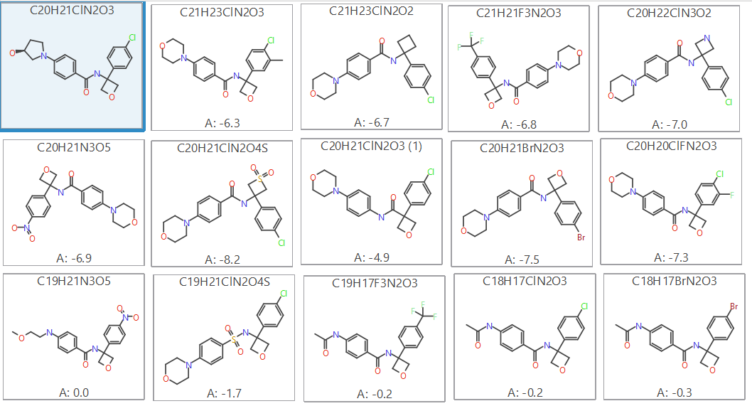
Prediction of 14 molecules retained from the proposed chemistry set (Set 1)
Predicted binding energy (Kcal/mol) of molecules you suggested
Crystalized ligand (green box)
Molecules with predicted similar range of activity (blue box) while better activity is shown in red box

